Slide 1

Sign Language Recognition Using AI and ML
Group: 24
Group Name: AI CON
Guide Faculty: Dr. G Elangovan

Slide 2








Group 24 AI CON
Subham
Rishabh
Priyam
Yashaswi
20BAI10051
20BAI10060
20BAI10087
20BAI10327

Slide 3
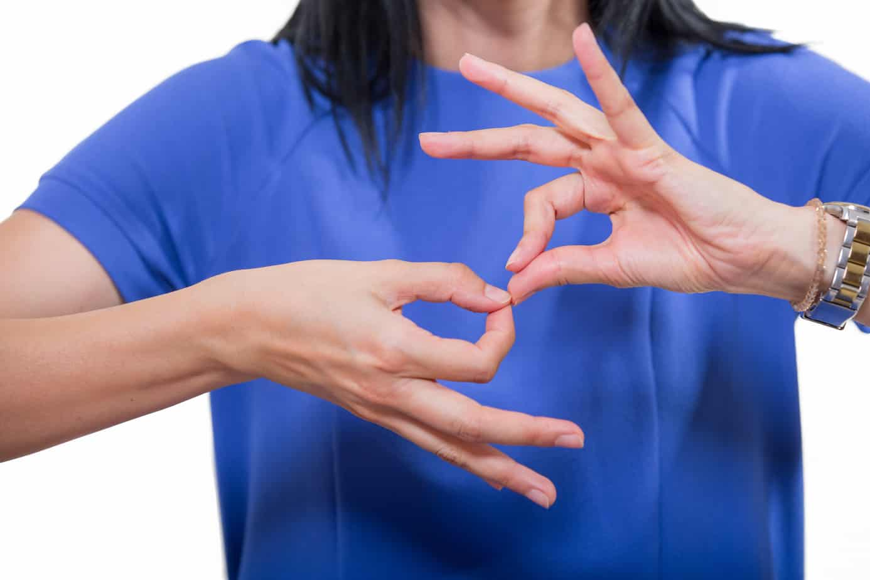
INTRODUCTION
System of communication using visual gestures and signs, as used by deaf people is called a Sign Language.
It is mainly expressed by movements of the hands and face. It is the primary language for the deaf people, who finds difficulty in hearing and who can hear but can't speak.
Helpful for people who struggles in developing verbal communication.

Slide 4

Challenges Faced By Deaf People
People who are hearing impaired face considerable challenges.
Public address systems notify us of what’s going on all the time, but a hearing-impaired individual probably won’t get the message.
Deaf People faced a great problem in order to convey their message to the perfect hearing people.
Studies reveal that deaf people are around twice as likely to suffer from psychological problems such as depression and anxiety. Research suggests this stems from feelings of isolation.

Slide 5

Existing Work with Limitation
Unavailability of Translator for the Deaf People in Some Area.
There are many instances of professional interpreters using the wrong words or misinterpret the meaning due to the variations across regions and country.
Difficulties in the Education Sector for the Deaf Students.
Getting Ignored in the Job Interviews situations.
Deafness can cause Depression and Anxiety and many more psychological problems.
Lack of Innovation or Technology for the Deaf People.

Slide 6

PROPOSED WORK
A Sign Language Recognition Application which helpful in every field for the deaf people.
No need of Translator.
Can be used in any location and in any situation.
Application can improve itself with the help of Machine Learning and can increase its efficiency and accuracy.

Slide 7
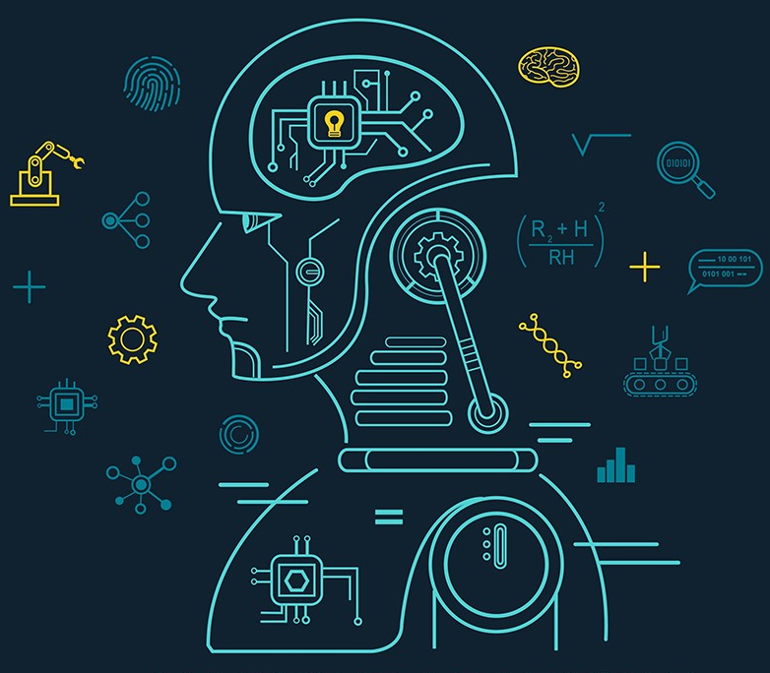
Methodology
To Gather Data
Arrange Data in Proper Layers
Creating the Model
Training Model
Testing
Result Analysis

Slide 8
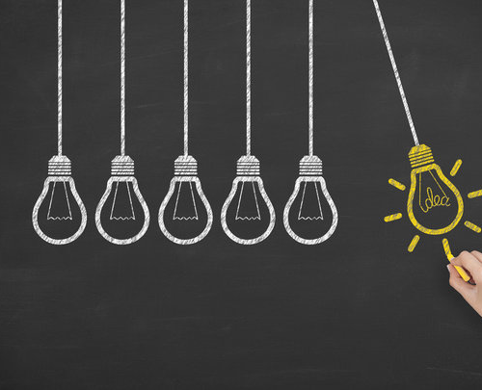
Novelty of the Project
Helps Deaf People to Communicate with People in India
Provides us to incorporate various kind of Indian Hand Signs
Can added various kind of sign in it
Diverse kind of Hand Sign

Slide 9



Real Time Usage
In the age of Pandemic communication in sign language is very difficult in video communication methods as the stage is always dominated by vocal audience.
Enabling real time sign language detection needs high volume data and heavy computational capabilities.
We have tried to create a light weight using our own resources.
We believe that we can develop as well as increase the accuracy.

Slide 10





Hardware & Software Required
Good Processor
Good Camera
High End Graphics Card

Slide 11
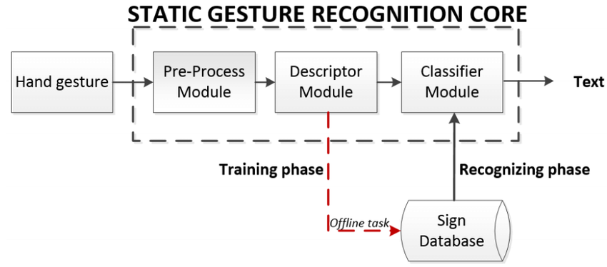
FLOW CHART

Slide 12
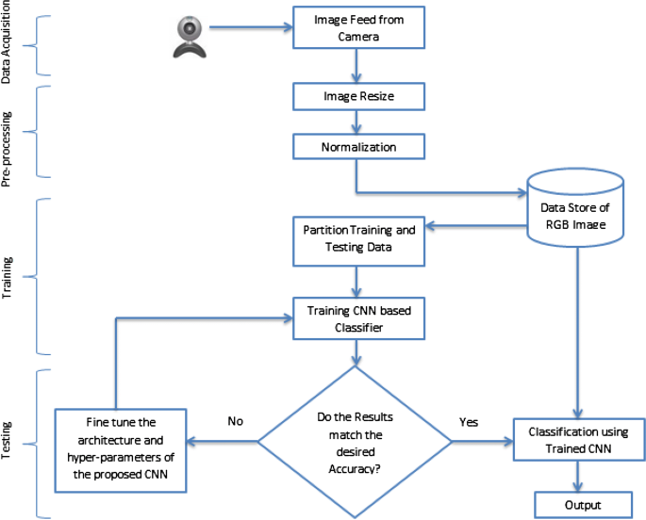
System Architecture Diagram

Slide 13

Literature Review
Lionel Pigou employed two networks, each with three layers of convolution and a max-pooling layer. They used the CLAP14 dataset, which consisted of 20 Italian gestures performed by 27 participants. They obtained a cross-validation accuracy of 91.7 percent using different users with various backgrounds from the training set, and a testing accuracy of 95.68 percent using the same users and backdrops.
For the dataset acquired using the Open NI + NITE framework on Microsoft Kinect, Alina K. employed a multi-layered Random Forest model. For participants on whom the system had been taught, they attained an accuracy of 87 percent, compared to 57 percent for fresh patients.
For hand segmentation, B. Liao employed a depth sensing camera and the Hough transform, as well as CNN for training. They classified 24 motions from the American Sign Language system with 99.4 percent accuracy (ASL).

Slide 14


Libraries

Slide 15
Model Training

Slide 16
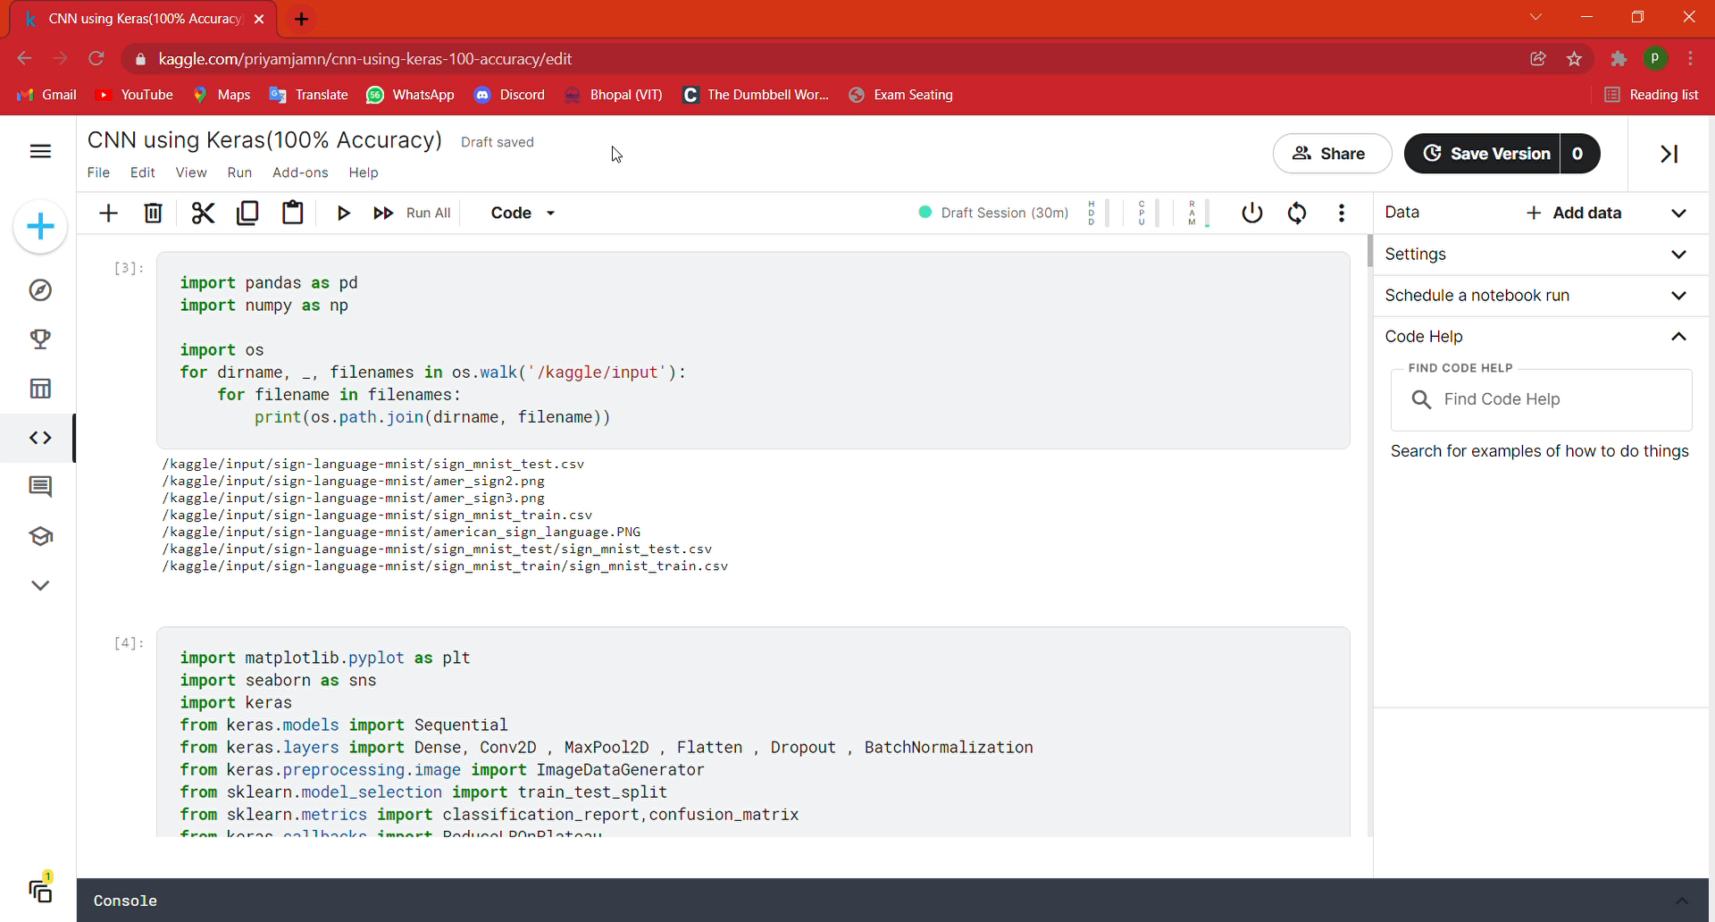

Slide 17
Snapshot

Slide 18
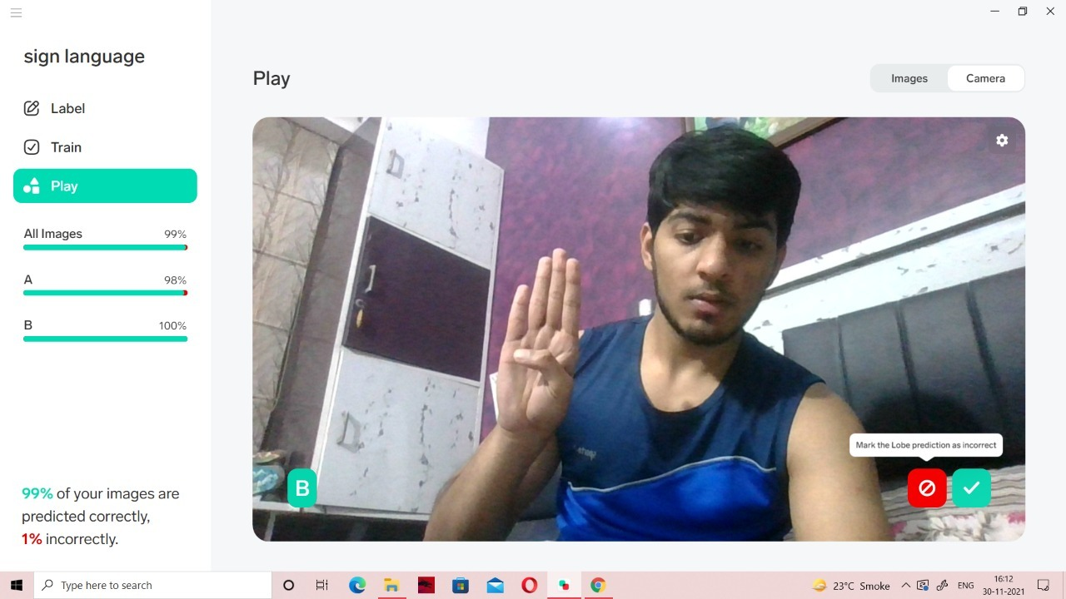

Slide 19
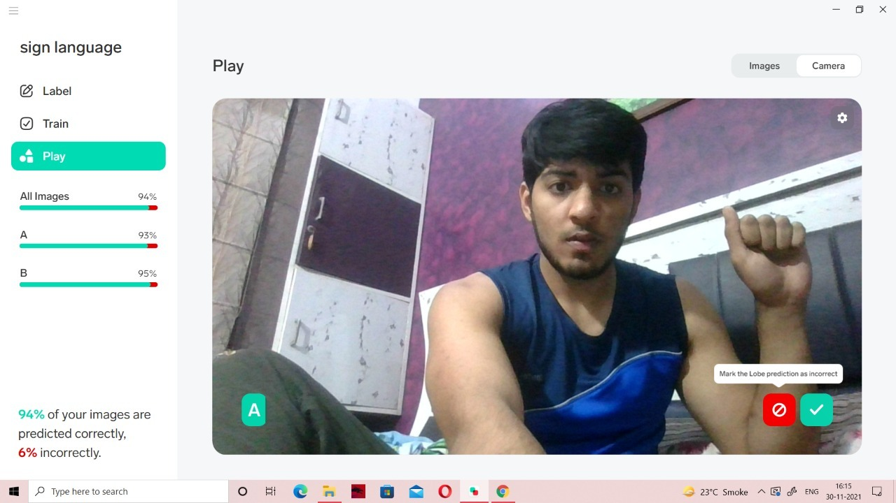

Slide 20
Demo Video

Slide 21
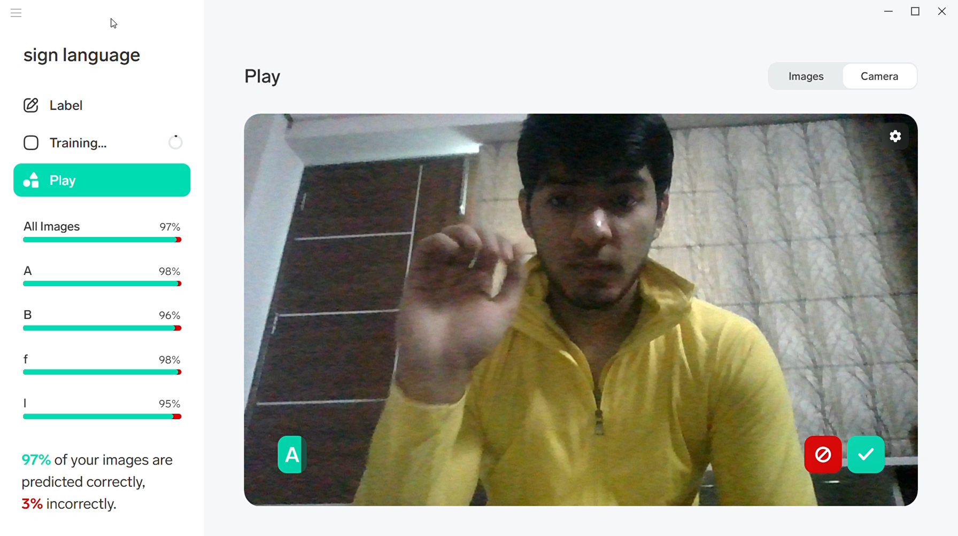

Slide 22

Results
The training accuracy attained using the picture dataset without any augmentation was quite good (about 99 percent), however the real-time performance was not up to par. Because hand-gestures were not positioned exactly in the middle and aligned vertically in real time, it was predicting inaccurately most of the time. We trained our model by supplementing our dataset to solve this limitation. Although the training accuracy was dropped to 89%, the real-time predictions were mostly accurate.
Also, whilst we growth our schooling photo length the accuracy betters itself each at some stage in schooling and actual time implementation (because the variety of parameters to gain knowledge of increases). However, schooling snap shots with massive length is without delay proportional to the computational energy of the system.

Slide 23


Conclusion
The goal of this project is to predict ISL alphanumeric hand gestures in real time. Previous work shows that it can be solved more precisely if we look at segmented RGB hand gestures. By using depth-based targeting, we eliminate dynamic background overloads. We were able to achieve a training accuracy of 89.30% and a test accuracy of 98.5%. Our model showed good accuracy in predicting the results.

Slide 24

References
https://www.skyfilabs.com/project-ideas/sign-language-translator-using-python
https://data-flair.training/blogs/sign-language-recognition-python-ml-opencv/
https://cse.iitk.ac.in/users/cs365/2015/_submissions/vinsam/report.pdf
Book Name:
Machine Learning: A Probabilistic Perspective (Adaptive Computation and Machine Learning Series.
The Elements of the Statistical Learning: Data Mining, Inference and Prediction.

Slide 25

Acknowledgement
We would like to thank our mentor Dr. G Elangovan Sir for supporting us and giving us this wonderful opportunity of presenting such a great project which will be very interesting, and I will also extend my gratitude to all the team members who cooperated and give their best in this project.

Slide 26


